Slide 1
Engine Project
Objective: To study Specific Fuel Consumption variability and determine Cpk values for its parameters
Aditya Oak
4th year Mechanical Engineering
Lokmanya Tilak College Of Engineering, Navi Mumbai

Slide 2
SFC
SFC (Specific fuel consumption) is the ratio that compares the fuel used by the engine to the amount of power the engine produces. Specific fuel consumption allows manufacturers to see which engine use the least fuel while still producing high amount of power. It allows engines of all different sizes to be compared to see which is the most fuel efficient.
A lower number equals a higher efficiency because the engine is creating a high level of power while using a low amount of fuel. Diesel engines typically perform better than gasoline engines in term of BSFC.
Commonly BSFC is expressed in units of grams per kilowatt-hour (g/kW·h).

Slide 3


What is Cp?
C_{p}
LSL
USL
Spec Width
(Engg Spec)
Process
Width
Target
Spec Width
Process width
C_{p} =
=

Slide 4
What is Cpk?
C_{pk}
LSL
USL
Dist from
Spec
Dist from
Proc Edge
Target
{Process Centre to Spec Edge}
{Process Centre to Process Edge}
C_{pk} =
=

Slide 5
Interpreting Cpk
“C_{pk} is an index (a simple number) which measures how close a process is running to its specification limits, relative to the natural variability of the process. The larger the index, the less likely it is that any item will be outside the specs.”
“C_{pk} measures how close you are to your target and how consistent you are to around your average performance. A person may be performing with minimum variation, but he can be away from his target towards one of the specification limit, which indicates lower C_{pk}, whereas C_{p} will be high.

Slide 6
Connecting Rod
MVML – Chakan

Slide 7
Big End

Slide 8
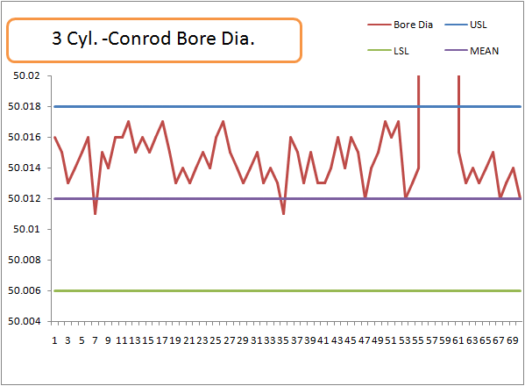
Conrod BE Bore Dia. 3 Cylinder engine
Sample Size 70 Conrods
Data Collection : 2 Days – July13 at MVML

Slide 9
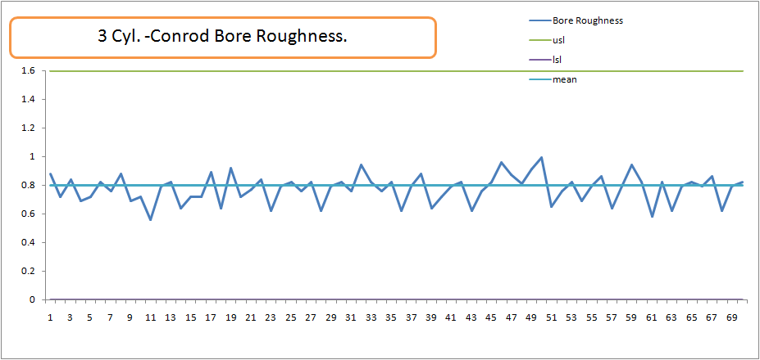
ConRod BE Bore Roughness 3 Cylinder engine
Sample Size 70 Conrods
Data Collection : 2 Days – July13 at MVML

Slide 10
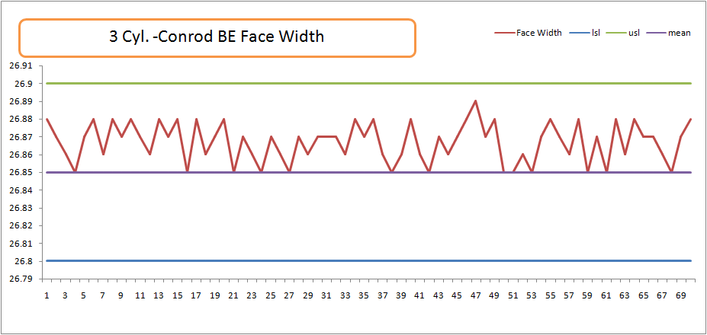
ConRod BE Face Width 3 Cylinder engine
Sample Size 70 Con.rods
Data Collection : 2 Days – July13 at MVML

Slide 11
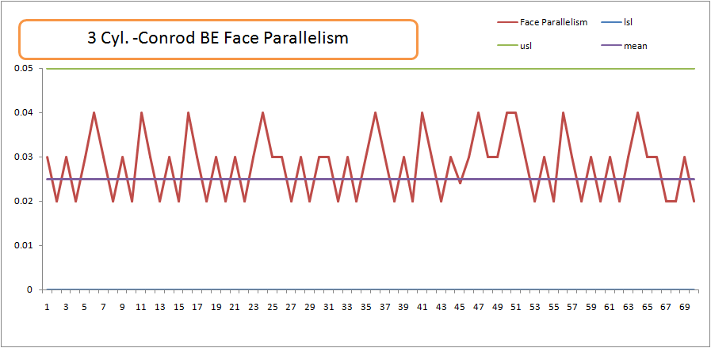
ConRod BE Face Parallelism 3 Cylinder engine
Sample Size 70 Con.rods
Data Collection : 2 Days – July13 at MVML

Slide 12
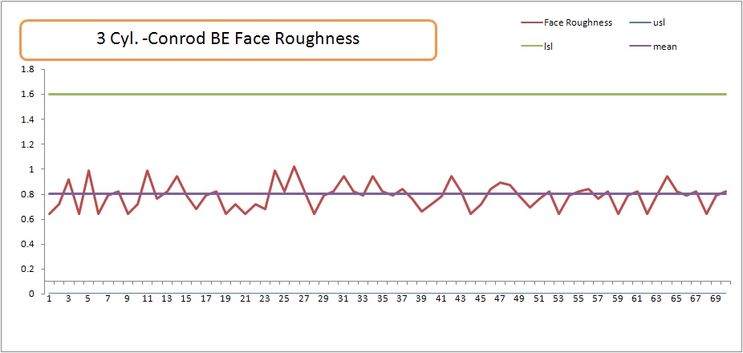
ConRod BE Face Roughness 3 Cylinder engine
Sample Size 70 Con.rods
Data Collection : 2 Days – July13 at MVML

Slide 13
Small End

Slide 14
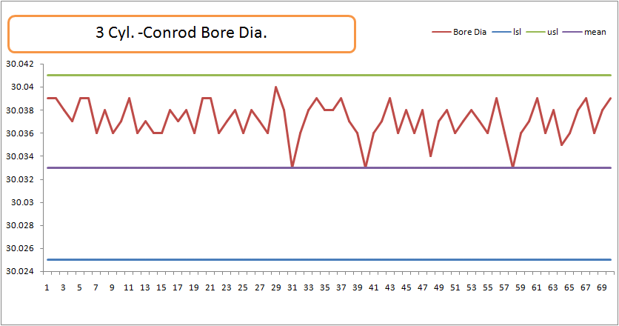
ConRod SE Bore Dia. 3 Cylinder
Sample Size 70 Conrods
Data Collection : 2 Days – July13 at MVML

Slide 15
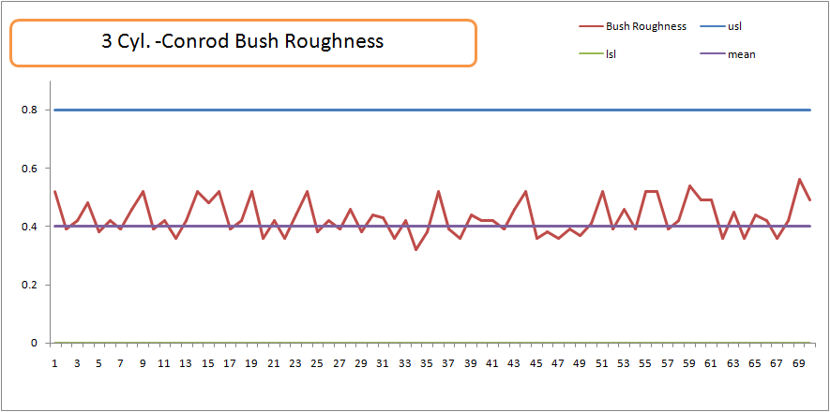
ConRod SE Bush Roughness
Sample Size 70 Conrods
Data Collection : 2 Days – July13 at MVML

Slide 16
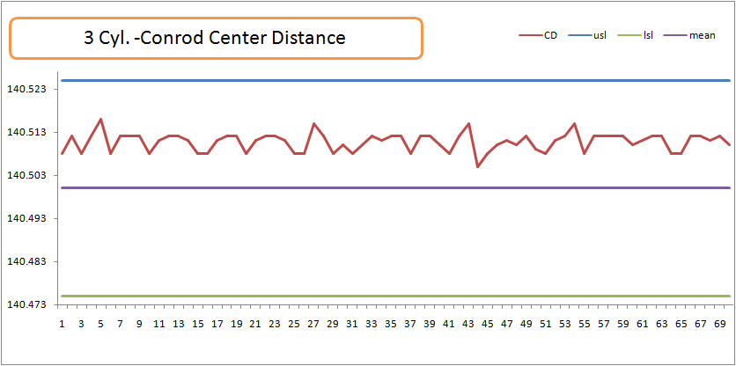
ConRod Centre Distance
Sample Size 70 Conrods
Data Collection : 2 Days – July13 at MVML

Slide 17
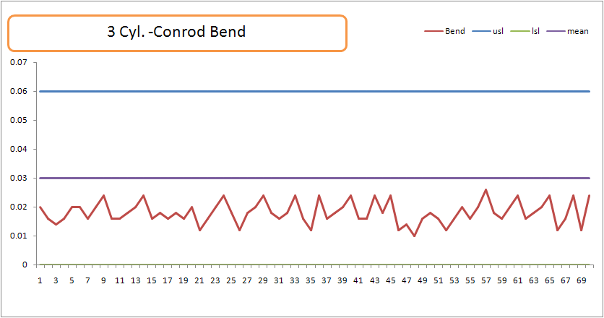
ConRod Bend 3-Cylinder

Slide 18
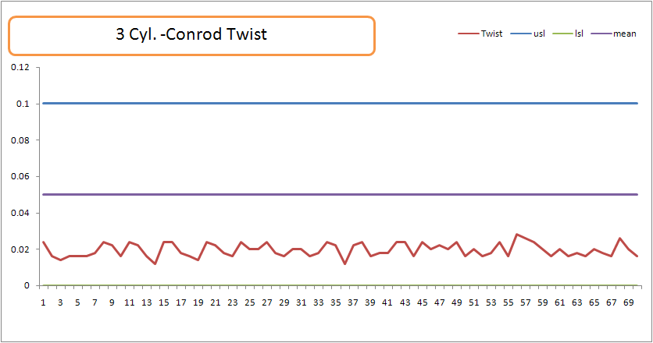
ConRod Twist 3-Cylinder

Slide 19
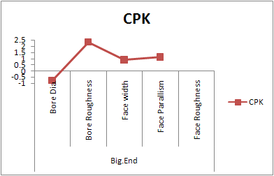
CPK

Slide 20
Thank you
Visit our website at www.mahindra.com

